Slide 1
Linux Basics
Linh Nguyen
This training materials are reused from multiple sources including FSOFT materials and Freescale training document, public document
Internal Used Only

Slide 2
Agenda
Basic of bash shell
Makefile
Introduce Linux process and thread
Introduce Yocto

Slide 3
What is a command shell?
A program that interprets commands
Allows a user to execute commands by typing them manually at a terminal, or automatically in programs called shell scripts.
A shell is not an operating system. It is a way to interface with the operating system and run commands.

Slide 4
basic commands
pwd
cd
ls
ps
grep
find
echo
cat
mkdir
rm
tar
env
df
chmod
xargs
history
less
which
Whereis
ssh
scp
wc
awk
cut
….

Slide 5
What is BASH?
BASH = Bourne Again SHell
Bash is a shell written as a free replacement to the standard Bourne Shell (/bin/sh) originally written by Steve Bourne for UNIX systems.
It has all of the features of the original Bourne Shell, plus additions that make it easier to program with and use from the command line.
Since it is Free Software, it has been adopted as the default shell on most Linux systems.

Slide 6
How is bash different from DOS cmd
Case sensitivity: bash is case sensitivity, but DOS is not.
“/” vs. “\”: In DOS, the forward-slash “/” is the command argument delimiter, while the backslash “\” is a directory separator. In Linux/UNIX, the “/” is the directory separator, and the “\” is an escape character.

Slide 7
The PATH variable
PATH is an environmental variable in Linux that tells the shell which directories to search for executable files in response to commands issued by a user.
Usually defined in /etc/bash.bashrc & ~/.bashrc
Example:
PATH=/usr/bin:/bin:/usr/local/bin
Separated by “:” character
System will search the command from left to right
Can get current PATH by “echo $PATH” command

Slide 8
Special characters
\: Escape character. If you want to reference a special character, you must “escape” it with a backslash first.
Ex: touch /tmp/filename\*
/: Directory separator, used to separate a string of directory names.
Ex: /usr/src/linux
.: Current directory. Can also “hide” files when it is the first character in a filename.
..: Parent directory
~: User's home directory. Ex: cd ~/Documents
*: Represents 0 or more characters in a filename, or by itself, all files in a directory.
Ex: pic*2002 can represent the files pic2002, picJanuary2002, picFeb292002, etc.

Slide 9
Special characters (cont)
?: Represents a single character in a filename.
Ex: hello?.txt can represent hello1.txt, helloz.txt, but not hello22.txt
[ ]: Can be used to represent a range of values, e.g. [0-9], [A-Z], etc.
Ex: hello[0-2].txt represents the names hello0.txt, hello1.txt, and hello2.txt
|: “Pipe”. Redirect the output of one command into another command.
Ex: ls | less
>: Redirect output of a command into a new file. If the file already exists, over-write it.
Ex: ls > myfiles.txt
>>: Redirect the output of a command onto the end of an existing file.
Ex: echo “Mary 555-1234” >> phonenumbers.txt
<: Redirect a file as input to a program.
Ex: more < phonenumbers.txt

Slide 10
Special characters (cont)
;: Command separator. Allows you to execute multiple commands on a single line.
Ex: cd /var/log ; less messages
&&: Command separator as above, but only runs the second command if the first one finished without errors.
Ex: cd /var/logs && less messages
&: Execute a command in the background, and immediately get your shell back. Same as non-blocking call model.
Ex: find / -name core > /tmp/corefiles.txt &

Slide 11
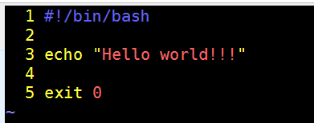
BASH hello world
shebang/hash-bang (#!): tells the system which interpreter used to execute the file Must appear at the very beginning of the first line. In other words, they must be the first two bytes of the file.
BASH script code
Run the script and get output

Slide 12
BASH variable
Does not have type definition
Declare by: <var_name>=[value] (no spaces at =)
Used by: $var_name, ${var_name}
Delete by: unset <var_name>
Print to console by: printf, echo
Read from console by: read
Numeric variable: var_num=1
String variable: var_str=“This is string”
Math expression: var_num=`expr $var_num + 1`

Slide 13
BASH special variables
$0: contains command that you used to run the script
$1->: the argument number 1->
$#: number of positional argument
$@: array of positional arguments
$$: PID of current process
$?: exit code of last command (returned by exit command)

Slide 14
BASH testing an expression [ ]
test is a built-in command of BASH, it evaluates many kinds of expressions, from file properties to integers to strings.
Alternate version of test is [ … ] (space after [ and before ])
File test:
[ -f ~/test ] # True if ~/test is a regular file
[ -e /etc/fstab ] # True if file /etc/fstab exists
Integer test:
[ x -eq 1 ] # True if x == 1
[ x -ne 1 ] # True if x != 1
[ x -gt 1 ] # True if x > 1
String test:
[ x = “a” ] # True if x content is equal to “a”
[ x != “a” ] # True if x content is not “a”

Slide 15
BASH evaluate expression [[ ]]
[[ ]] is BASH shell grammar, not command
Supports same operator as test
More than test, it can evaluate regular expression
string=“whatever”
[[ $string =~ h[aeiou] ]] # True
[[ $string =~ h[sdfghijk] ]] # False

Slide 16
BASH eval arithmetic expression (( ))
A nonstandard feature, (( arithmetic expression )) returns false if the arithmetic expression evaluates to zero and returns true otherwise
((verbose)) && command ## execute command if verbose != 0
if (( total > max )); then : ...; fi

Slide 17
BASH conditional operators
<command 1> && <command 2>: do <command 2> after and if <command 1> return True
<command 1> || <command 2>: do <command 2> after and if <command 1> return False
[ -f /etc/fstab ] && cat /etc/fstab || echo “not exists”
[ -f /etc/fstaba ] && cat /etc/fstab || echo “not exists”
Notes:
<condition> && <command1> || <command2> is equal to if <condition>; then <command1>; else <command2>; fi

Slide 18
BASH branch with if
Syntax:
if <condition list>
then
<commands>
fi
On one line:
if <condition list>; then <commands>; fi
Example:
read x;
if [ x == “” ]; than echo “[Empty]”; else echo “${x}”; fi

Slide 19
BASH branch with case
Syntax:
case WORD in
PATTERN) COMMANDS ;;
PATTERN) COMMANDS ;; ## optional
esac
Example:
case $1 in
*[!0-9]*) false;;
*) true ;;
esac

Slide 20
BASH loop
While loop
while <list>
do
<list>
done
Until loop
until <list>; do <list>; done
For loop
for (( n=1; n<=10; ++n )); do echo "$n”; done
for var in Canada USA Mexico; do printf "%s\n" "$var”; done

Slide 21
BASH function
Syntax:
<function_name>()
{
<commands>;
}
Function argument is $1, $2, … same as script file arguments
Example
sum() { return $(( $1 + $2 )); }
sum 5 3
echo $? # 8

Slide 22
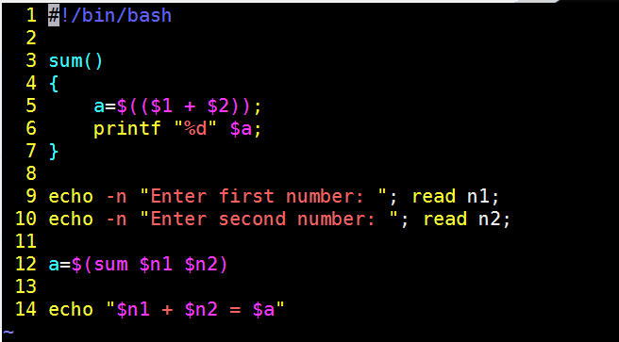
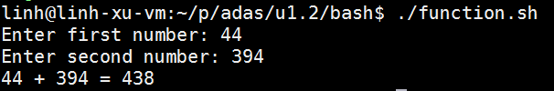
BASH script

Slide 23
Q & A

Slide 24
Makefile
The make utility is a software tool for managing and maintaining computer programs consisting many component files. The make utility automatically determines which pieces of a large program need to be recompiled, and issues commands to recompile them.
Makefile sets a set of rules to determine which parts of a program need to be recompile, and issues command to recompile them.
Makefile is a way of automating software building procedure and other complex tasks with dependencies.
Makefile contains: dependency rules, macros and suffix(or implicit) rules.

Slide 25
Makefile dependency rule
hello: hello.c hello.h
gcc hello.c -o hello
Dependencies
Commands of rule
Target
Tab character. NOT space. Tab is used before each command of a target
Each rule tells the make program how to execute the rule.

Slide 26
Makefile dependency rule (cont.)
The target is the file or thing that must be made
A phony target is one that isn't really the name of a file.
Typing “make target” will:
1. Make sure all the dependencies are up to date
2. If target is older than any dependency, recreate it using the specified commands.
By default, typing “make” creates first target in Makefile.
The common target: all, clean, install, uninstall, distclean

Slide 27
Makefile dependency rule (cont.)
The prerequisites or dependents are those files that must exist before the target can be successfully created. The prerequisites or dependents are those files that must exist before the target can be successfully created.
When execute a rule, firstly all dependents must be satisfied. If any dependent is not, make program will find the rule to make the dependent. It looks like recursive function. Until all dependents are satisfied, the commands of the rule will be executed.

Slide 28
Makefile rule’s commands
The command can be shell command, make function, macro
Some special macros that useful when using shell command
-: ignore the command result (continue on error)
clean:
-rm *.o *~ prog
@: do not echo the command (print the command)
%.o: %.c
@echo “Compiling $? ...”
@$(CC) $(CFLAGS) -c $?

Slide 29
Makefile variable (macro)
Two kind of variable
Simply expanded CC := gcc $(FLAGS). The value of FLAGS will be expanded and assign the result to CC immediately.
FLAGS = -Wall
CC := gcc $(FLAGS) <- at this time, CC is “gcc -Wall”
Recursively expanded CC = gcc $(FLAGS). The value of FLAGS will be expanded and assign the result to CC when the $(CC) is used.
FLAGS = -Wall
CC = gcc $(FLAGS) <- at this time, CC’s value is not specified.
FLAGS += -Wnot-used
CMD := $(CC) <- at this time, CC value was calculated, it’s “gcc –Wall –Wnot-used” and assigned to CMD
FLAGS += -DDEBUG_ON
CMD2 := $(CC) <- CC is expanded to “gcc –Wall –Wnot-used –DDEBUG_ON” and assigned to CMD2

Slide 30
Makefile special macro
$@ The file name of the target.
$< The name of the first dependency.
$* The part of a filename which matched a suffix rule.
$? The names of all the dependencies newer than the target separated by spaces (changed dependents).
$^ The names of all the dependencies separated by spaces, but with duplicate names removed.
$+ The names of all the dependencies separated by spaces with duplicate names included and in the same order as in the rule.

Slide 31
Makefile conventional macro
AR | Archive-maintaining program; default is `ar'.
AS | Program for compiling assembly files; default is `as'.
CC | Program for compiling C programs; default is `cc'.
CXX | Program for compiling C++ programs; default is `g++'.
CPP | Program for running the C preprocessor, with results to standard output; default is `$(CC) -E'.
ARFLAGS | Flags to give the archive-maintaining program; default is `rv'.
ASFLAGS | Extra flags to give to the assembler when explicitly invoked on a `.s' or `.S' file.
CFLAGS | Extra flags to give to the C compiler.
CXXFLAGS | Extra flags to give to the C compiler.
CPPFLAGS | Extra flags to give to the C preprocessor and programs, which use it (such as C and Fortran compilers).
LDFLAGS | Extra flags to give to compilers when they are supposed to invoke the linker, `ld'.

Slide 32
Debug Makefile
--just-print: print every command it would execute without executing them.
--print-data-base: it will dump the internal database (variables, directories, implicit rules, files, search path).
--warn-undefined-variables: print warning when undefined variable was used.
--debug: print most detailed information. Have 5 options, basic, verbose, implicit, jobs, all

Slide 33
Sample program code
/* main.c */
#include “functions.h”
int main() {
…
mul(1,2);
sum(2,3);
…
return 0;
}
/* functions.h */
#ifndef __FUNCTIONS_H__
#define __FUNCTIONS_H__
int sum (int a, int b);
int mul (int a, int b);
#endif
/* multiply.c */
#include “functions.h”
int mul(int a, int b) {
return a * b;
}
/* sum.c */
#include “functions.h”
int sum (int a, int b) {
return a + b;
}

Slide 34
Compile without Makefile
Compile program
gcc -c main.c sum.c multiply.c
gcc -o prog main.o sum.o multiply.o
Change one file & recompile
gcc -c main.c
gcc -o prog main.o sum.o multiply.o

Slide 35
So simple Makefile
CC=gcc
CFLAGS= -c -Wall
LDFLAGS=
all: prog
prog: main.o sum.o multiply.o
$(CC) $(LDFLAGS) main.o sum.o multiply.o -o prog
main.o: main.c
$(CC) $(CFLAGS) main.c
sum.o: sum.c
$(CC) $(CFLAGS) sum.c
multiply.o: multiply.c
$(CC) $(CFLAGS) multiply.c
clean:
rm -f *.o; rm -f prog;

Slide 36
A new Makefile with pattern rule
CC=gcc
CFLAGS= -c -Wall
LDFLAGS=
all: prog
prog: main.o sum.o multiply.o
$(CC) $(LDFLAGS) -o $@ $^
%.o: %.c
@echo “Compiling $? …”
@$(CC) $(CFLAGS) $?
clean:
-rm -f *.o; rm -f prog;

Slide 37
GNU autotools
Contains autoconf & automake
User need to define the project configuration (sources file, header file, version, binary name, …), the autotools will generate to configure script file. Depends on parameters, configure script will generate corresponding Makefile.
The step to build from source (package using autotools):
./configure [options]
make [options] && make install

Slide 38
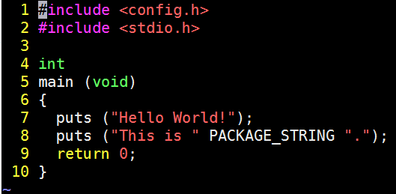


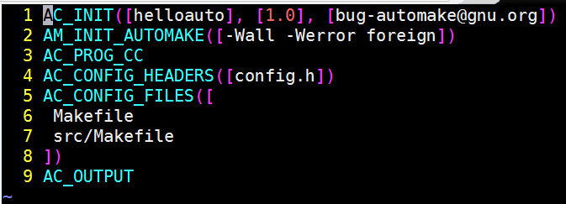
GNU autotools example
src/Makefile.am
src/main.c
Makefile.am
configure.ac

Slide 39
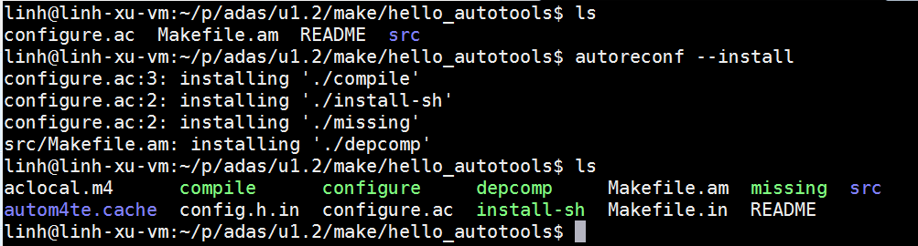
GNU autotools example (cont.)
Commands to build these kind of package
./configure [options]
make [options]
make install

Slide 40
Q & A

Slide 41
Process & Thread
Process
Thread
Mutex
Semaphore
Unix socket
Queue

Slide 42
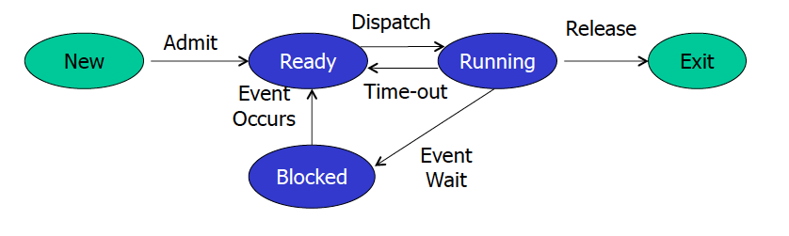
Process Concept
Process – a program in execution
Textbook uses the terms job and process almost interchangeably
A process includes:
program counter
stack
data section
Process life-cycle

Slide 43
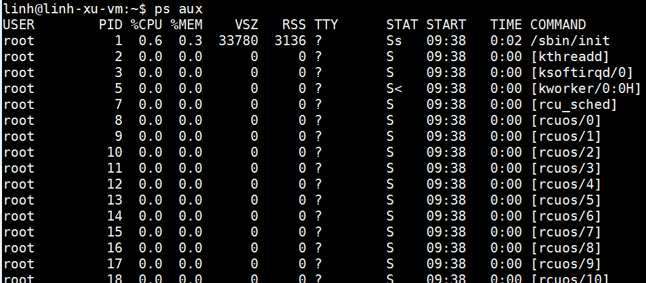
Get list of running processes

Slide 44
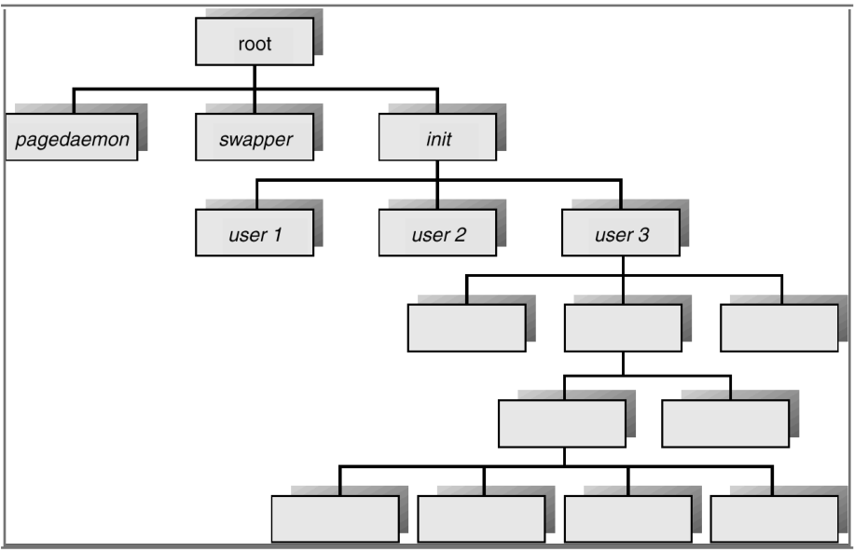
Processes Tree on a UNIX System

Slide 45
Thread
A thread (or lightweight process) is a basic unit of CPU utilization; it consists of:
Program Counter
Register set
Stack place
A thread shares with its peer threads its:
Code section
Data section
Operating-system resources
Know as a task

Slide 46
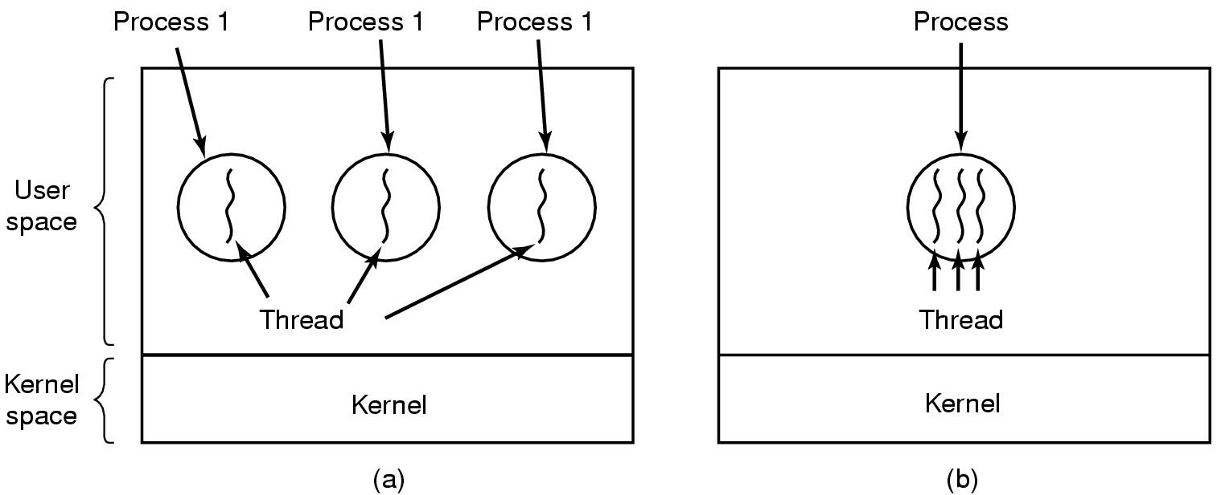
Thread
(a) Three processes each with one thread
(b) One process with three threads

Slide 47
Process vs Thread
Threads
Will by default share memory
Will share file descriptors
Will share filesystem context
Will share signal handling
Processes
Will by default not share memory
Most file descriptors not shared
Most file descriptors not shared
Don't share signal handling

Slide 48
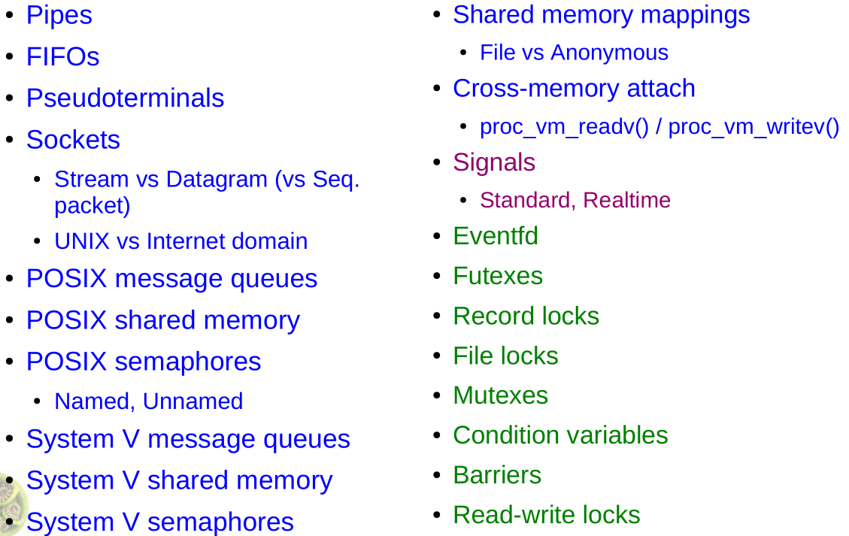
Inter-process Communication (IPC)
Communication
Signals
Synchronization

Slide 49
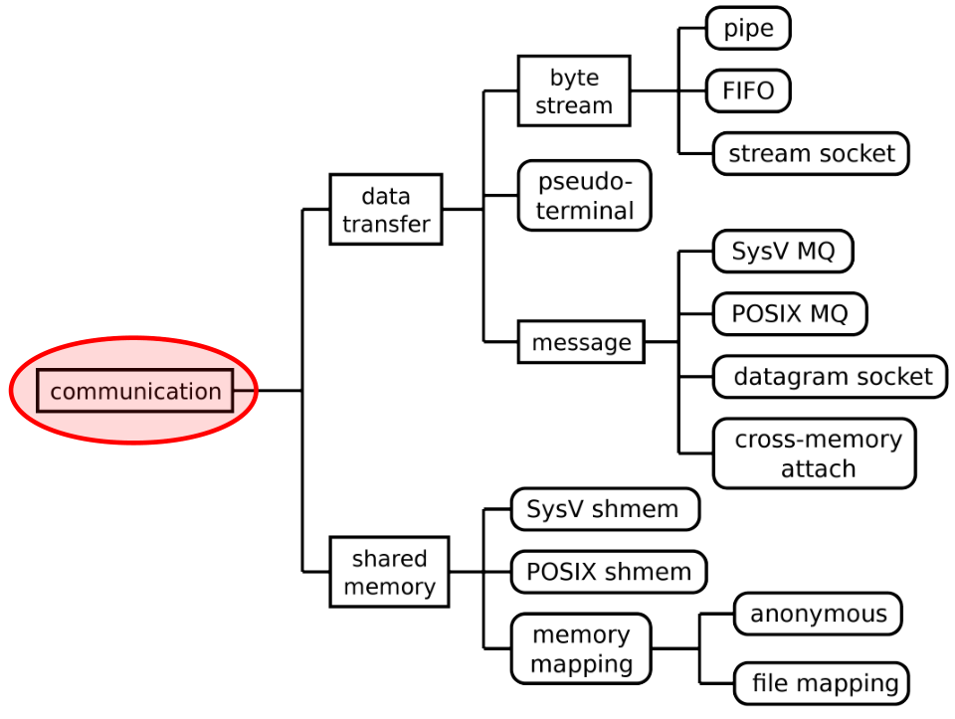
Communication IPC

Slide 50
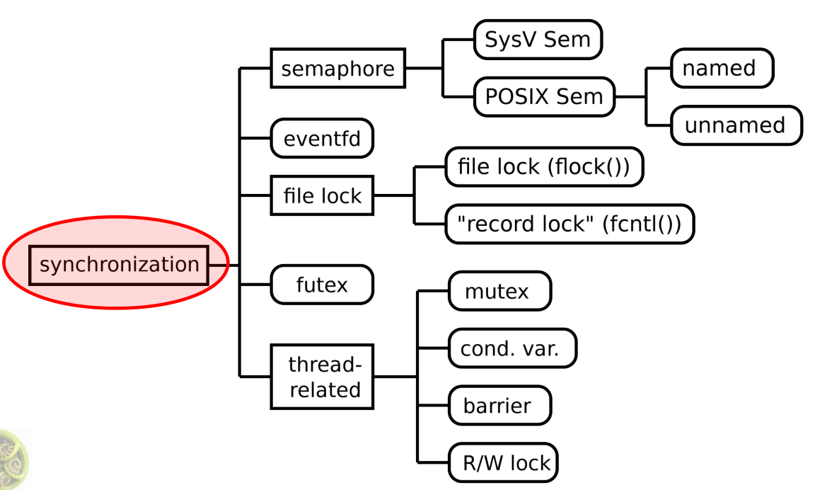
Synchronization IPC

Slide 51
Queue
Message queues can be best described as an internal linked list within the kernel's addressing space
Messages can be sent to the queue in order and retrieved from the queue in several different ways
msgget(): create a new message queue, or access an existing queue
msgsnd(): deliver a message to a queue
msgrcv(): retrieve the message from the queue
msgctl(): performs control operations on a message queue

Slide 52
Mutex
There are 3 tasks. Thread 2 locks the Mutex.
The task 1 tries to lock the Mutex but it is already locked so task 1 waits in the Mutex’s queue.
Thread 1
(H)
Thread 2
(M)
Thread 3 (L)
The task 2 unlocks the Mutex and the task 3 locks it.
The task 3 then tries to lock the Mutex but it is already locked so task 3 waits in the Mutex’s queue.
The task 3 unlocks the Mutex and the task 1 locks it.
Mutex
Mutex Queue
Thread 2
Thread 3
Thread 1
Resource

Slide 53
Semaphore
Thread 1 post the semaphore, count increase to 1. Then thread 3 can get the semaphore.
Thread 3 post the semaphore, count increase to 1.
Thread 1 access the semaphore without wait, count down to 1.
Create semaphore with initial value is 2
Thread 3 access the semaphore. Push into semaphore queue
Thread 2 access the semaphore without wait, count down to 0.
Semaphore Queue
Thread 1
Thread 3
Thread 2
Semaphore
Count: 0
Count: 2
Count: 1
Thread 3
Resource

Slide 54
Semaphore example
We have a Bounded buffer (ring buffer): size ‘N’
The access entry is 0… N-1, then “wrap around” to 0 again
Producer Thread writes data to buffer
Must not write more than ‘N’ items more than consumer “ate”
Consumer Thread reads data from buffer
Should not try to consume if there is no data
A semaphore is used to have the control of the available space in the buffer.
0
1
N-1
Semaphore = 3
Semaphore = 4
Producer
Consumer

Slide 55
Unix Socket
inter-process-communication mechanism that allows bidirectional data exchange between process running on the same machineCreate socket: unix_socket = socket(AF_UNIX, type, 0);
Bind socket address: bind(fd, (struct sockaddr*)&addr, sizeof(addr))
Server wait and accept connection: accept(fd, NULL, NULL)
Client connect: connect(fd, (struct sockaddr*)&addr, sizeof(addr))
Read data: rc=read(cl,buf,sizeof(buf)
Write data: rc=write(fd, buf, len)

Slide 56
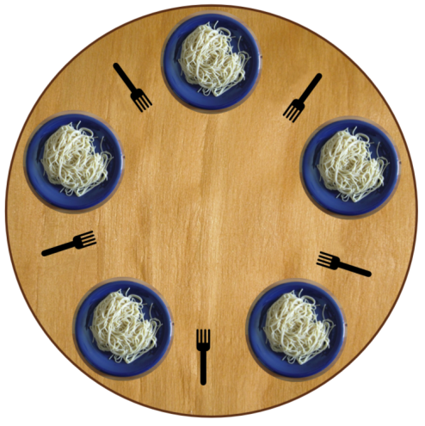
Dining Philosophers

Slide 57
Q & A

Slide 58
Yocto
Introduction to the Yocto Project
Yocto Project Build System
Yocto Project Workflow
Quick Start Guide in a Slide

Slide 59
What is the Yocto Project?
Distribution build environment and tools for embedded
Supports ARM, PPC, MIPS, x86 (32 & 64 bit)
Open source project with a strong community
Content
Complete Linux OS with package metadata
Releases every 6 months with latest (but stable) kernel, toolchain, and package versions, Cutting-edge metadata tracking a variety of open source upstreams
Common Linux BSP format and reference images, place for Industry to publish BSPs
App Dev Tools which allow development against the stack, including Eclipse plug-ins and emulators
Full documentation representative of a consistent system It’s not an embedded Linux distribution – It creates a custom one for you.

Slide 60
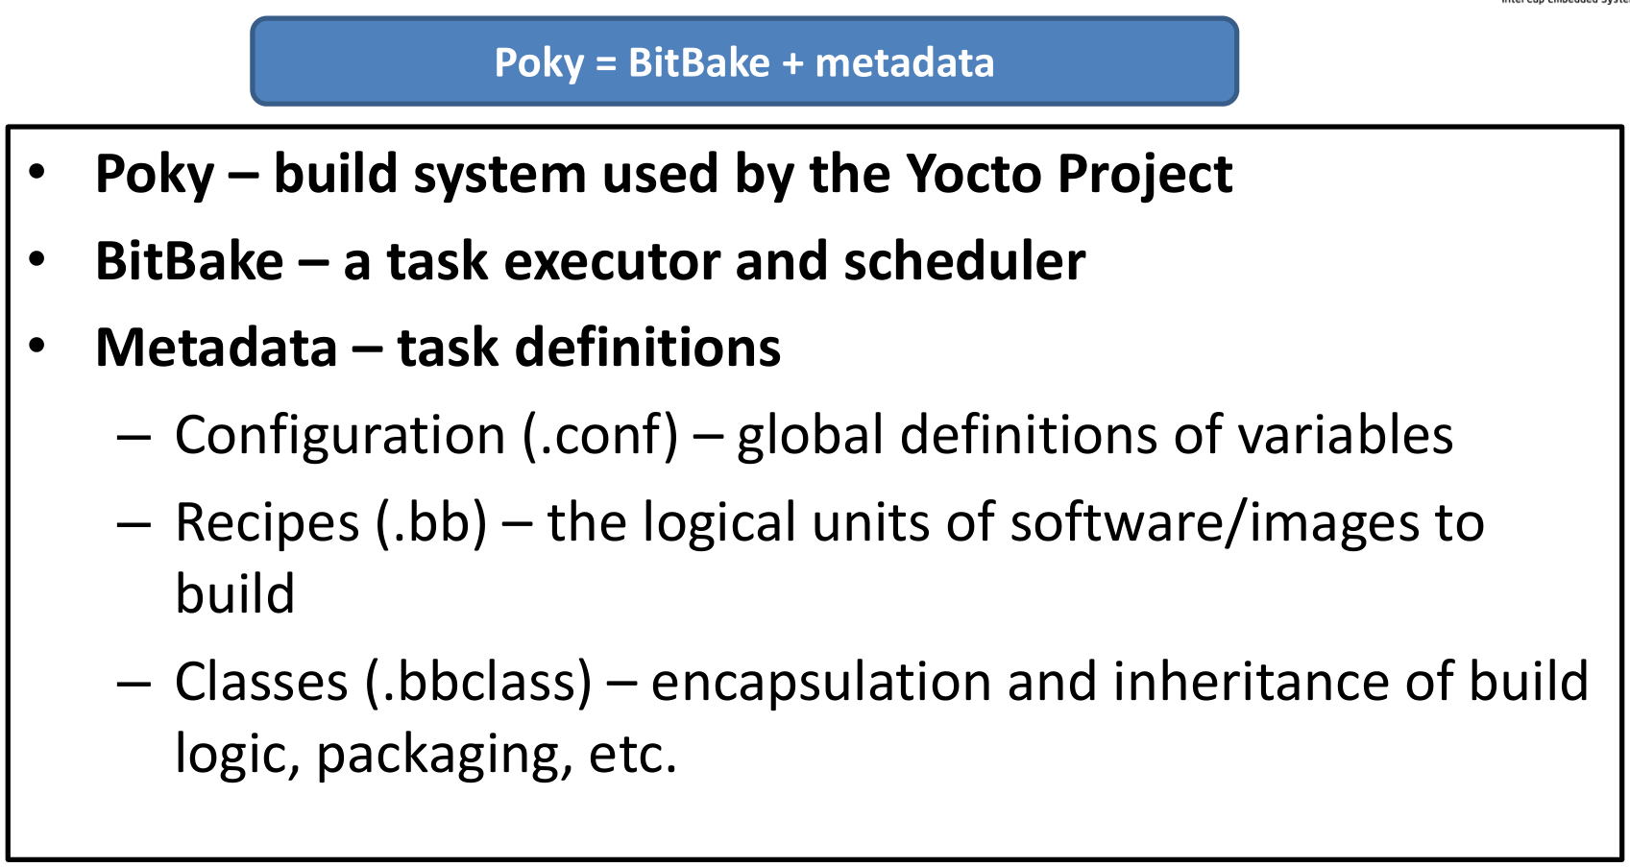
Yocto Project Build System

Slide 61
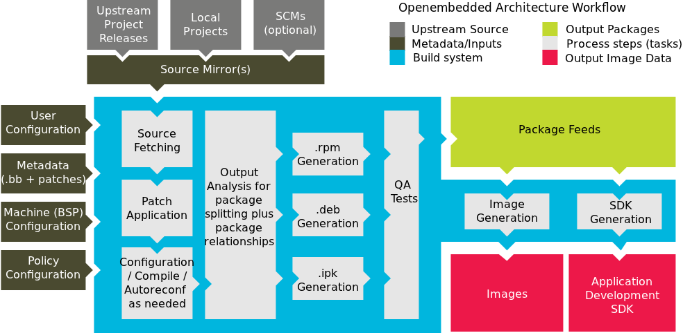
Yocto Project Workflow

Slide 62
Quick Start
Obtain the poky source:
git clone git://git.yoctoproject.org/poky
Build a Linux image
$ cd poky; source oe-init-build-env
$ MACHINE=qemux86 bitbake core-image-sato
Run the image under emulation:
runqemu qemux86
For more detailed info, see the Quick Start guide
http://www.yoctoproject.org/documentation

Slide 63
Yocto for Freescale ARM
https://github.com/Freescale/fsl-community-bsp-platform/
Install the repo utility
$: mkdir ~/bin
$: curl http://commondatastorage.googleapis.com/git-repo-downloads/repo > ~/bin/repo
$: chmod a+x ~/bin/repo
Download the BSP source
$: PATH=${PATH}:~/bin
$: mkdir fsl-community-bsp
$: cd fsl-community-bsp
$: repo init -u https://github.com/Freescale/fsl-community-bsp-platform
$: repo sync

Slide 64
Yocto for Freescale ARM (cont.)
Configure your build
$: source ./setup-environment build
Edit conf/local.conf user config
MACHINE ?= "twr-vf65gs10“
BB_NUMBER_THREADS = "4“
PARALLEL_MAKE = "-j 4“
DL_DIR ?= “<path>/downloads/”
SSTATE_DIR ?= “<path>/sstate”
Start build
$: bitbake core-image-minimal

Slide 65
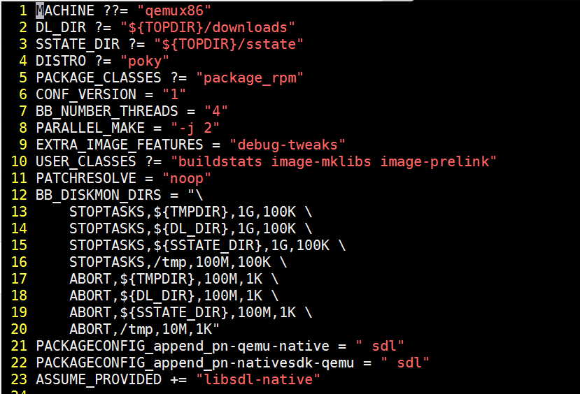
Yocto build configuration
conf/local.conf

Slide 66
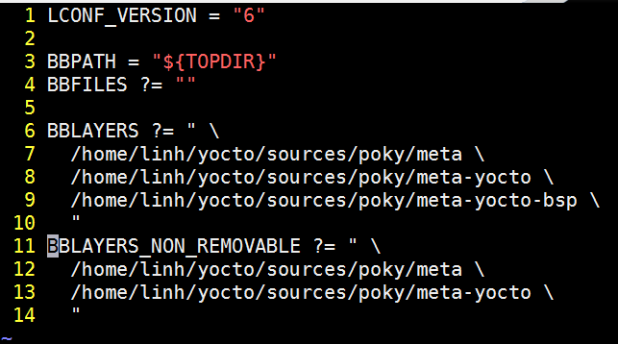
Yocto build configuration
conf/bblayers.conf

Slide 67
Yocto common targets
core-image-minimal: A small image to boot a device and have access to core command line commands and services.
core-image-sato: Image with Sato support. Sato is a GNOME mobile-based user interface.
meta-toolchain: Includes development headers and libraries to develop directly on the target.
meta-ide-support: Generates the cross-toolchain. Useful when working with the SDK.
adt-installer: Build the application development toolkit installer.
Usually defined in */receipes-*/images/
./poky/meta/recipes-sato/images/
./meta-fsl-arm/recipes-graphics/images

Slide 68
Yocto commands (bitbake commands)
bitbake [options] [recipename/target …]
bitbake foo: build target foo
bitbake –b foo-0.1.bb: build recipe foo-0.1.bb
bitbake –c clean foo: clean target foo
bitbake –c fetchall foo: download all requirements for target foo
bitbake –b foo-0.1.bb –c fetch: Download requirement for recipe foo-0.1.bb

Slide 69
Yocto commands (bitbake commands)
bitbake <image> -g -u depexp: show package dependency for image
bitbake <package> -c devshell: Open a new shell where with neccesary system values already defined for package
bitbake <package> -c listtasks: list all tasks for the package
bitbake virtual/kernel -c menuconfig: Interactive kernel configuration

Slide 70
Yocto result
tmp/buildstats/ Build statistics for all packages built (CPU usage, elapsed time, host, timestamps...).
tmp/deploy/ Final output of the build.
tmp/deploy/images/ Contains the complete built images. These images are used to flash the target.
tmp/sysroots/ Shared libraries and headers used to compile packages for the target but also for the host.
tmp/work/ Set of specific work directories, split by architecture. They are used to unpack, configure and build the packages. Contains the patched sources, generated objects and logs.

Slide 71
Customize yocto image
Create custom .bb file: copy the image .bb file to new file then update IMAGE_INSTALL variable (IMAGE_INSTALL += screen)
Edit in local.conf: Using IMAGE_INSTALL with _append operator
IMAGE_INSTALL_append = “ screen”

Slide 72
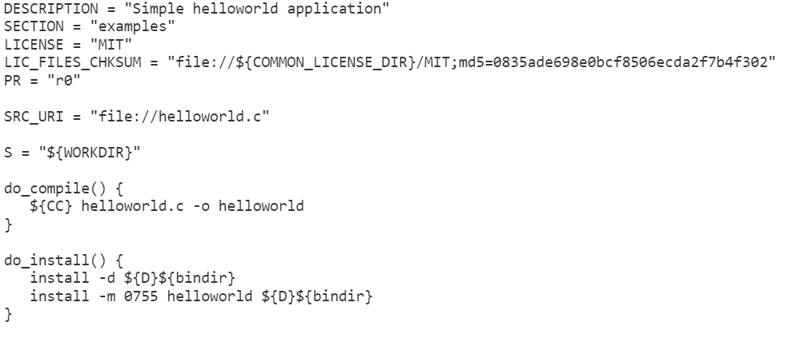
Write recipe for new package
Create new .bb file with content as following incase your package contains only one .c file

Slide 73
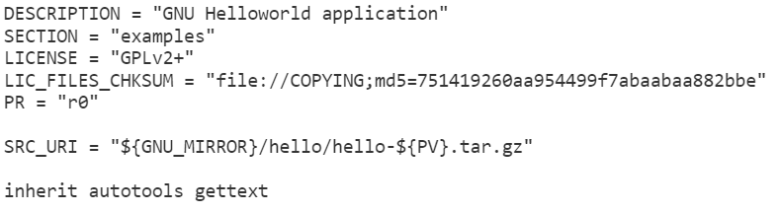
Write recipe for new package
Create new .bb file with content as following incase your package is autotools style

Slide 74
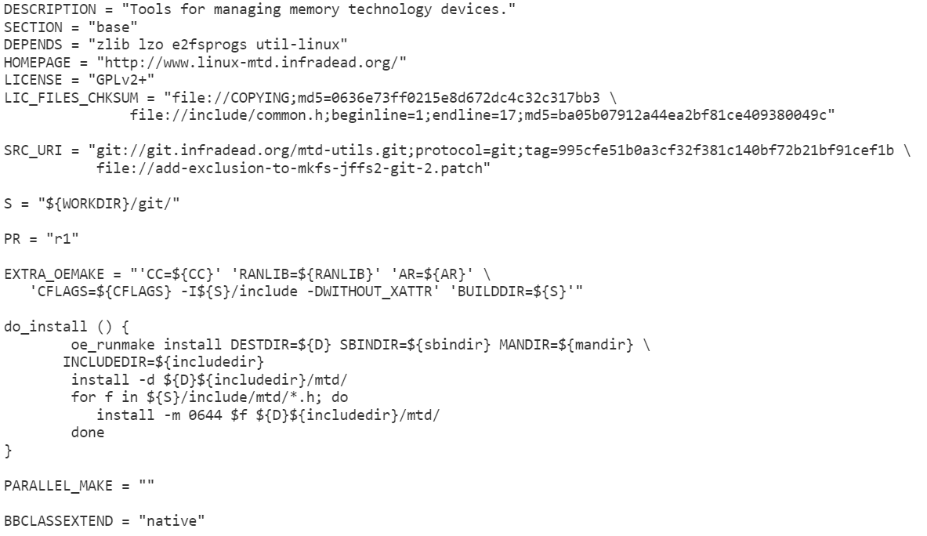
Write recipe for new package
Makefile-based package

Slide 75
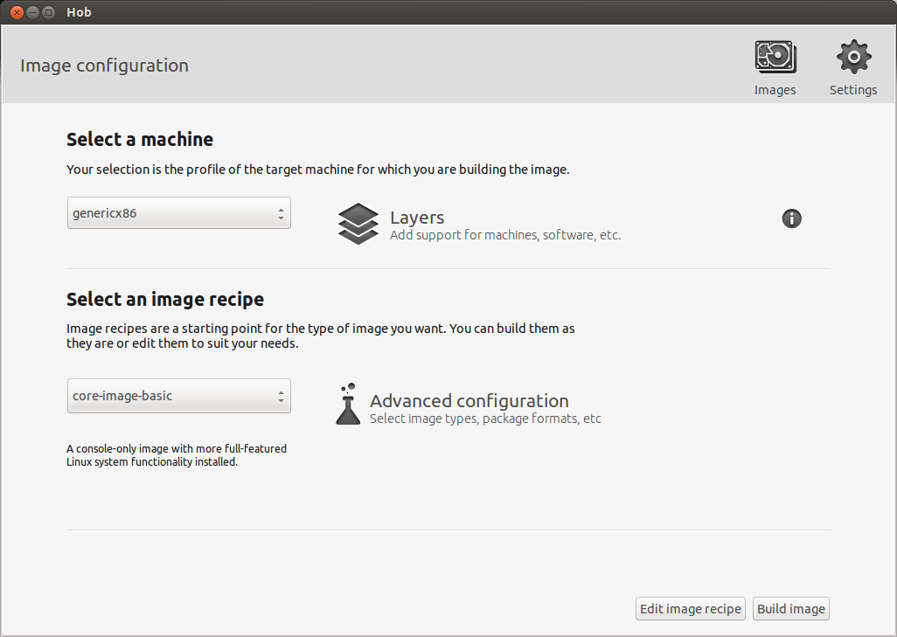
HOB – Yocto GUI tool

Slide 76
Q & A

Slide 77
Thank You!

